Slide 1
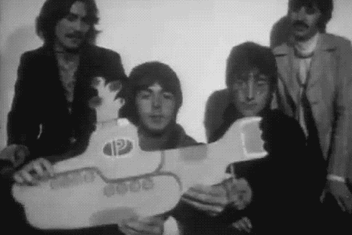


Unmanned Submarine Drone
Kathia Coronado
Edbin Gonzalez-Calderon
Damiano Falanga
Alexandra Santelli
Veronica Valerio

Slide 2
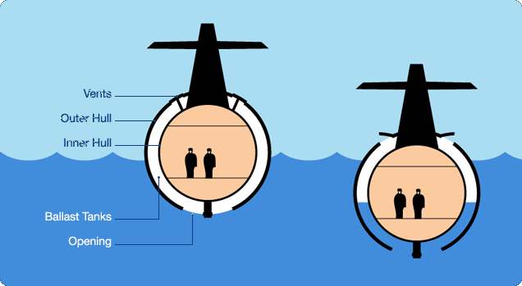
Introduction: How do Submarines Work?
Submarines control buoyancy to dive and resurface
Positive buoyancy
Air fills ballast tank
Negative buoyancy
Ballast tank takes in water
To Resurface
Compressed air expels water
Notes:
AMOEBA
A submarine control its buoyancy to dive and resurface at will
Positive buoyancy: overall density less than that of surrounding water
Negative buoyancy: overall density greater than that of surrounding water
To create positive buoyancy, the ballast tanks must fill with air
To create negative buoyancy, the ballast tanks must release air and take on water
To resurface, ballasts must be filled with compressed air to expel water

Slide 3
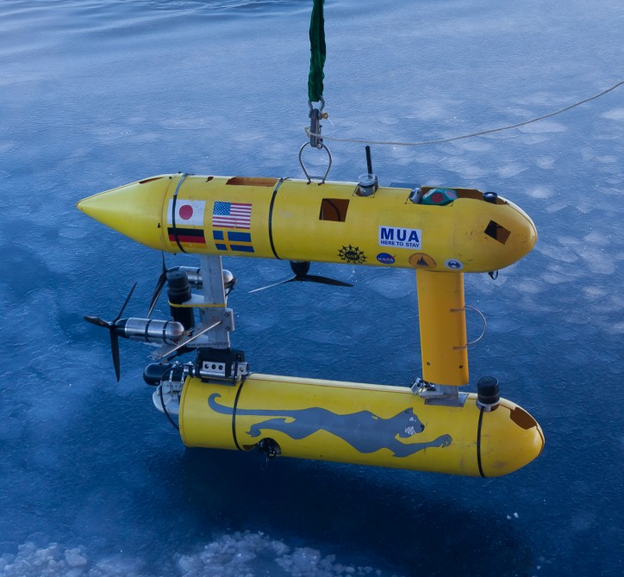
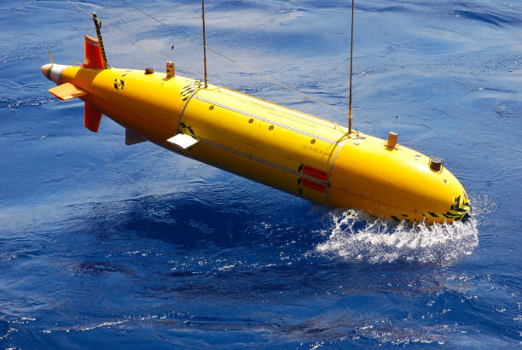
Submarine Drones
Autonomous Underwater Vehicles (AUV)
Useful for industry
Surveying infrastructure
Ocean mapping
Undersea mining
Deep sea drilling
Ship inspection
US Navy
Unmanned Underwater Vehicles (UUV)
Recreational or Professional Use
Expensive
Notes:
AMOEBA
https://iq.intel.com/submarine-drone-from-seabed-dives-into-the-deep-ocean-of-data/
1st picture =SeaBED team — comprised of scientists from the United States, the United Kingdom and Australia — released their impressively rendered high-resolution 3D maps of Antarctic sea ice.
https://www.hagmannreport.com/from-the-wires/it-begins-us-to-launch-submarine-drones-in-south-china-sea/
2nd picture = US navy submarine drone that was launched into the south china sea
CUT WORDS
ADD ANOTHER SLIDE… TALK MORE
Autonomous underwater vehicles (AUV) are popular for industrial uses
Examples of AUV applications:
Surveying infrastructure
Ocean mapping
US Navy
There are also Unmanned Underwater Vehicles (UUV) in the market for professional use
Typically more expensive than UUV intended for recreational use

Slide 4
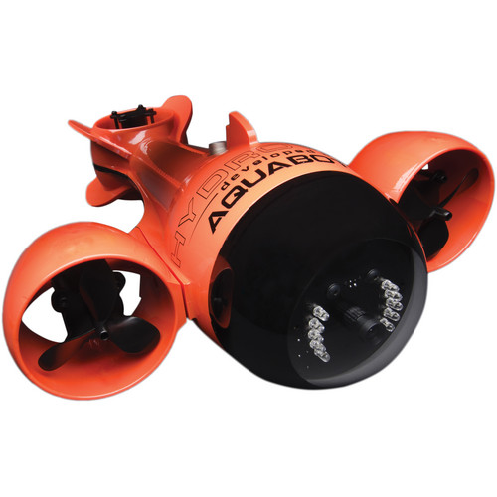
Existing Drones
Aquabotix HydroView Sport RC Underwater Vehicle
$5800
150 ft depth
75 ft tethered cable
2-3 hour battery life
4.6 km/hr full forward speed, 1.8 km/hr full reverse speed
2 lb payload
Notes:
https://www.bhphotovideo.com/bnh/controller/home?A=details&O=&Q=&ap=y&c3api=1876%2C%7Bcreative%7D%2C%7Bkeyword%7D&gclid=CjwKCAiA3o7RBRBfEiwAZMtSCVl0U3K_m5zGTS6AeQIbg2DIQ0qHS152w23dhk2ggUe82kAHVHidcxoCSOsQAvD_BwE&is=REG&sku=1033864
https://www.westmarine.com/buy/aquabotix--hydroview-pro-7m-mini-rov-with-camera--15710767?cm_mmc=PS-_-Google-_-GSC%2520-%2520Product%2520Type-_-15710767&product_id=15710767&adpos=1o4&creative=108421552444&device=c&matchtype=&network=g&mrkgadid=3076578738&mrkgcl=481&rkg_id=h-4b8a322111b94a421e4a76b354b806bf_t-1512354461&gclid=CjwKCAiA3o7RBRBfEiwAZMtSCdzf0lWLkEpUwOS1LA0YqxcqKphnrM7r4JCYPXhTc5wfVZyyO4VafxoC1QEQAvD_BwE
http://www.robotshop.com/en/endura-sle-remote-operated-underwater-vehicle-arm.html?gclid=CjwKCAiA3o7RBRBfEiwAZMtSCV4Ng71rpLtBh7QRiws9pTYE4oPC43gB-bmmJddO4Qs2SuCHEfYiyRoC9MQQAvD_BwE

Slide 5
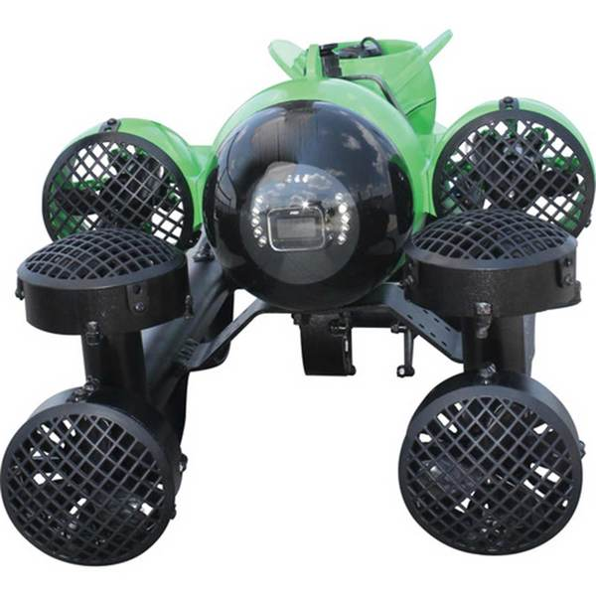
Existing Drones
HydroView Pro 7M mini ROV
$16,900
250 ft depth
250 ft tethered cable
3 hour battery life
4.6 km/hr full forward speed,
2.3 km/hr reverse speed

Slide 6
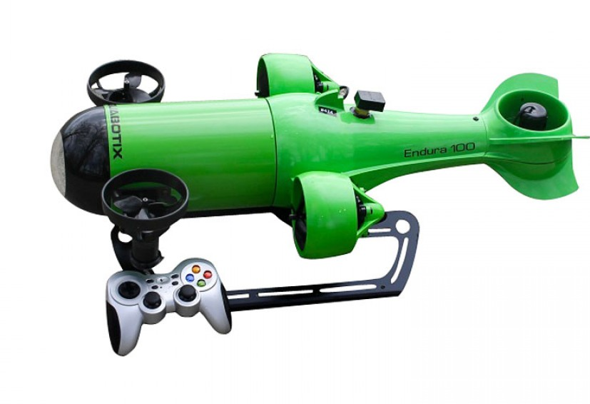
Existing Drones
Endura 100 Mini ROV Underwater Vehicle
$29,000
328 ft depth
Up to 328 ft tethered cable
4 hour battery life
5.6 km/hr forward speed
4 lb payload

Slide 7
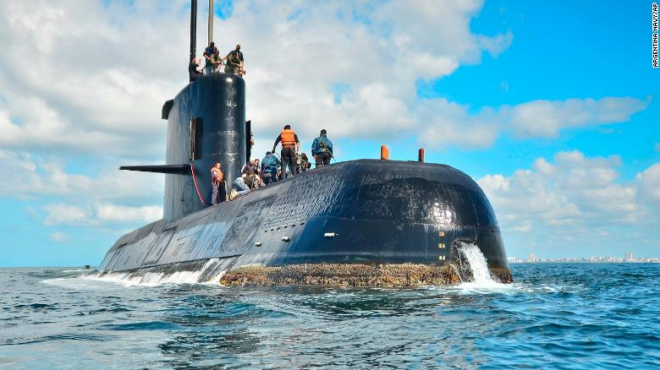
Objectives
Unmanned Underwater Vehicle
Remote Controlled
Wireless/Untethered
Cost Effective
Optimize performance
Minimize Cost
Unique Operating Envelope
Distinctive Communication System
Notes:
VENEZUELA

Slide 8
Specifications
Topics of Discussion | Specifications
Maximum depth | 3 m
Maximum range | 3 m
Speed of submarine | 10 m/s
Payload | 1 kg
Size | 100 mm x 250 mm
Cost | $500 budget
Notes:
VENEZUELA

Slide 9
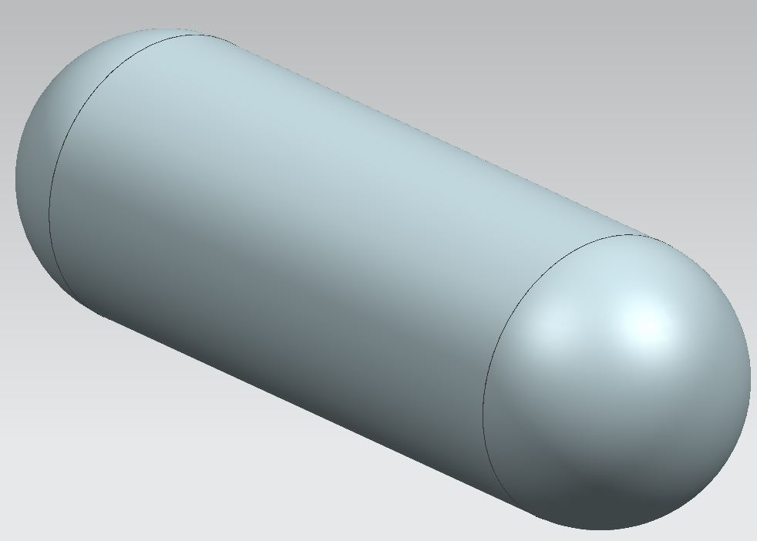
Initial Design: Body
Cylindrical shape
Ballasts located on both ends of body
Dead weight
Design density must be below 1029 kg/m³ to float (density of seawater)
Notes:
ELBIN
ADD NEW PIC WITH
NO PARTITIONS AND AXIS
Too many words
Current design follow cylindrical shape
Will use pump to expel water
Ballast tanks located on either end of the cylinder body
Inner compartment open for pump and communication system
Inner wall separating the ballast tank and body of the drone
Design density must be below 1029 kg/m³ to float

Slide 10
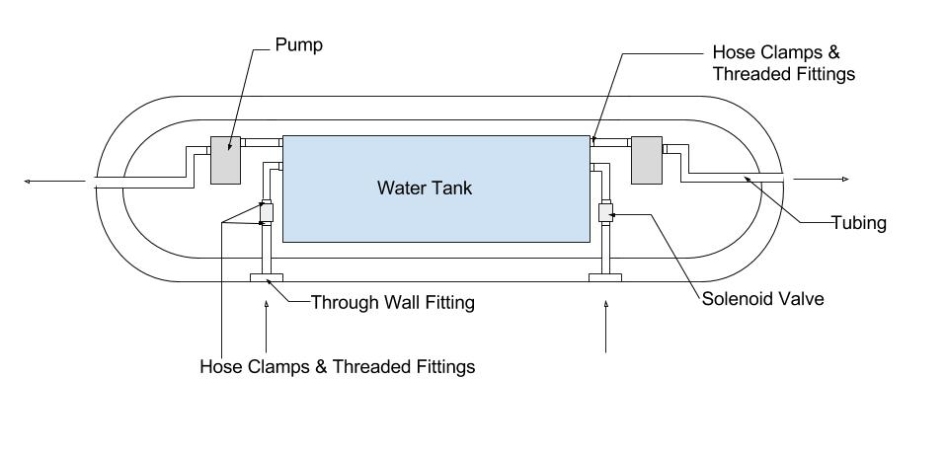
Initial Design: Water Flow
Notes:
AMOEBA

Slide 11

Design Challenges
Determine component compatibility
Pump vs. Piston
Piston is smaller, more powerful but more difficult to construct
Pump is easily available but not strong enough
Issues with communication system
Pings not sharp enough
Sound sensor not sensitive enough
Notes:
VENEZUELA
Pump vs. piston? → from that book walker gave us
Issues with communication system?
Other issues we’ve had
Peristaltic Liquid Pump
Designed to work well with water
Motor voltage of 12V
Flow rate of 100mL/min

Slide 12
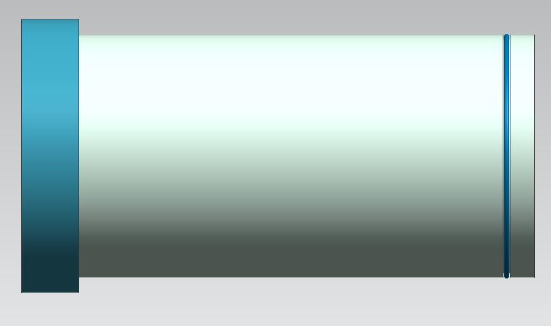
Current Design: Hull
Notes:
DAMINO
NEEDS PICS
Wirelessly communication Arduino and submarine drone via seawater
One-way communication between operator and drone
Three types of communications systems considered initially
Radio Frequency
Optical Communication
SONAR (Sound And Navigation Ranging) Technology

Slide 13
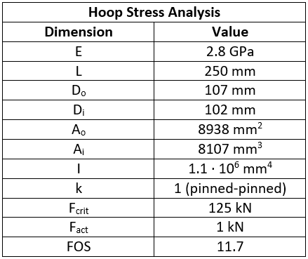
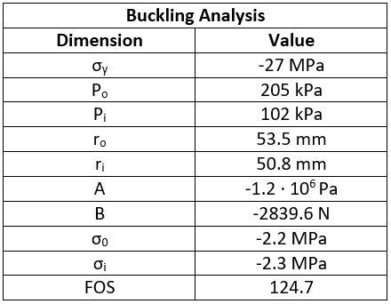
Hoop Stress and Buckling Analysis
Notes:
SWITCH THESE TITLES

Slide 14
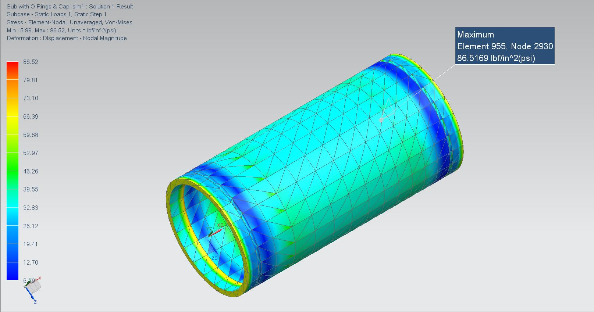
Hoop Stress Analysis of Hull
Boundary conditions
Half a hull
Longitudinal plane of symmetry
End caps not included
Conservative result
Tetrahedral mesh
1 inch nominal size
Loading conditions
Internal pressure: 14.7 psi
External pressure: 19.6 psi
Max Stress is 86.5 psi
Notes:
Yield stress of PVC 8 ksi

Slide 15
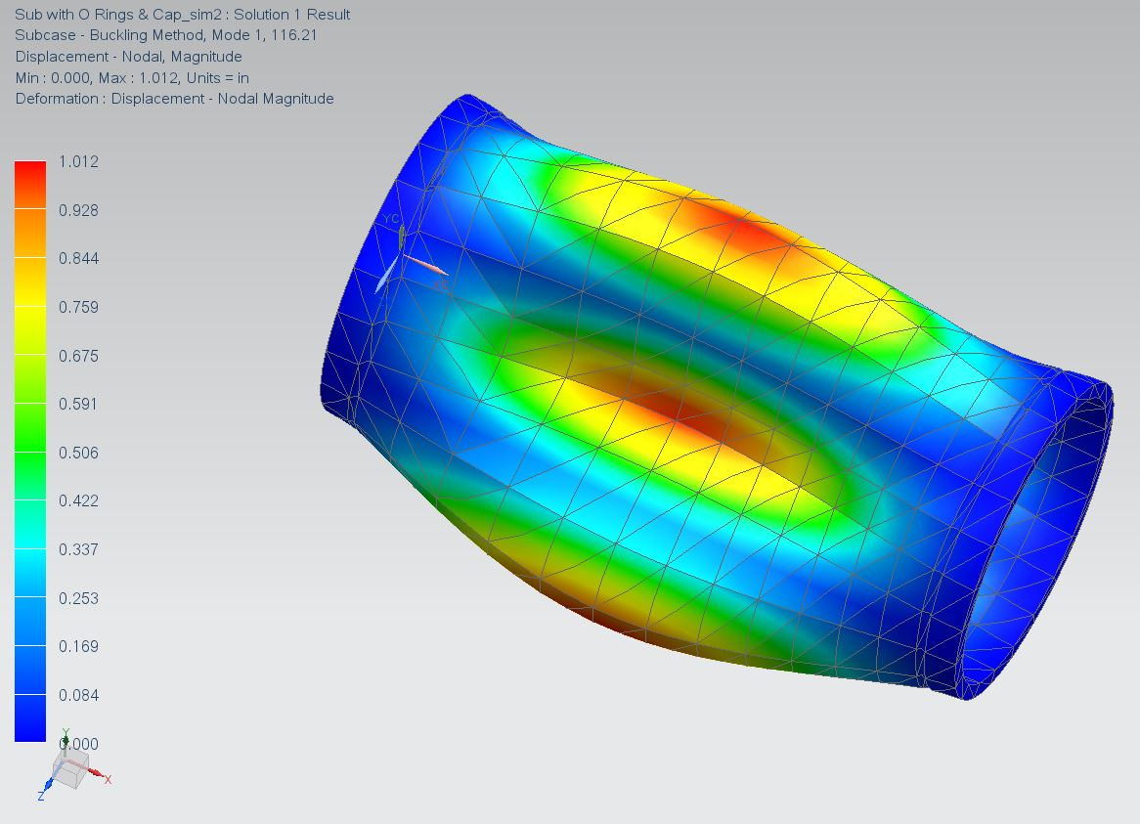
Buckling Analysis of Hull
Boundary conditions
Half a hull
Longitudinal plane of symmetry
End caps not included
Conservative result
Tetrahedral mesh
1 inch nominal size
Loading conditions
Internal pressure: 14.7 psi
External pressure: 19.6 psi
(FOS: 116.2)

Slide 16
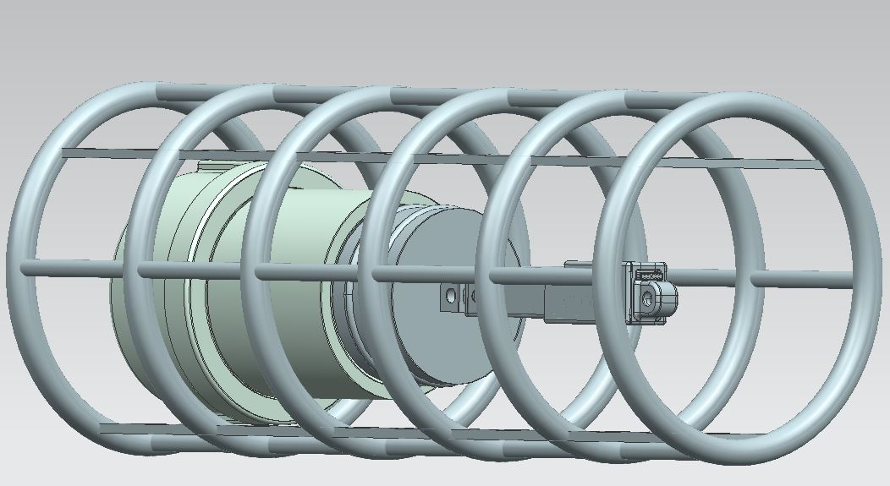
Current Design: Equipment Frame
Notes:
DAMINO
NEEDS PICS
Wirelessly communication Arduino and submarine drone via seawater
One-way communication between operator and drone
Three types of communications systems considered initially
Radio Frequency
Optical Communication
SONAR (Sound And Navigation Ranging) Technology

Slide 17
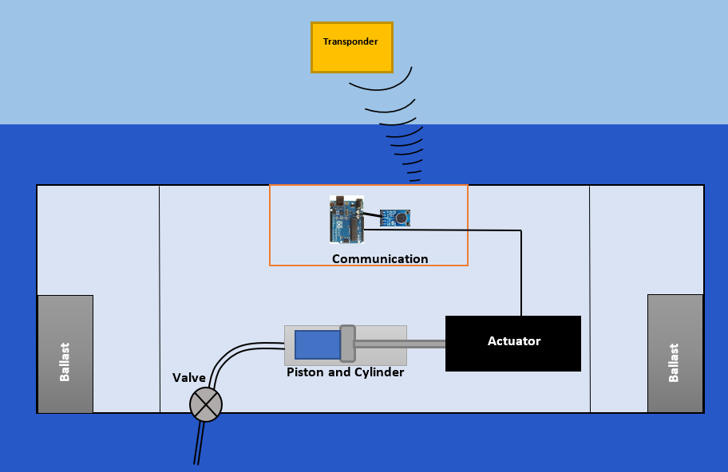
Current Design: Internal Layout
Notes:
ELBIN
What our final design is at the end of this semester
yep

Slide 18
Current Design: Water Ejection
Notes:
ELBIN
What our final design is at the end of this semester
yep

Slide 19
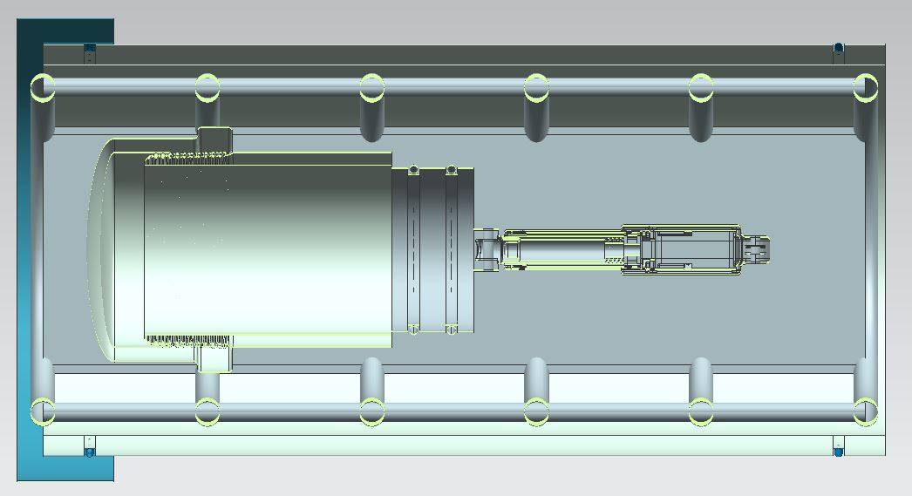
Current Design: Water Ejection
Stainless Steel Pipe
Actuator
Threaded Pipe Fitting
Piston
Notes:
ELBIN
We’ll be drilling a hole at the end of the cap that will connect the water piping to a valve which will allow water to enter
Piston and pipe will act like a syringe

Slide 20
Specification of Water Ejection Systems
Ballast Tank Cap
Material: 304 Stainless Steel
Max Pressure: 150 psi
Outer Diameter: 2.98 inches
Length: 1.77 inches
Ballast Tank
Material: 304 Stainless Steel
Outer Diameter: 2.375 inches
Inner Diameter: 2.067 inches
Length: 3 inches
Actuator
Closed Length: 3.22 inches
Stroke Length: 1.18 inches
Voltage: 12V
Max Speed: 1 inch per second
Piston
3-D Printed
Diameter: 2 inches
Length: 1 inch

Slide 21
Current Design: Communications
Notes:
KITHA
Now i will be talking about the communications system of our design

Slide 22
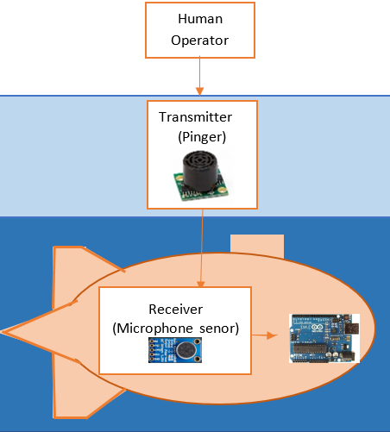
Current Design: Communications
Wireless/Untethered Communication
Remote Controlled Operation
Up, Down, Left, Right
Initial Considerations
Radio Frequency
Visible Light Communication (VLC)
Sound Navigation & Ranging (SONAR)
Custom SONAR communication System
Transponder
Receiver
3
Notes:
As previously mentioned, most underwater drones are designed to be either autonomous (AUV) or remotely operated with a tether
We want to create a submarine drone that is remotely operated from the surface of the water wirelesslly, so no tether.
3 basic types of communications are ...
RADIO FREQ
Electronmagnetic sigals (which have high frequencies and large band width at shorter distances ) cannote penetrate and propogate in deep underwater envrionments… attenuated in the water
LIGHT
LIGHT doesnt require a medium to travel, therefore when it passes through a medium (like water) it slows down significantly.wont beable to see it past a certain depth
Underwater, light is affected by: ,Depth, Subject distance,Weather and surface conditions
Water is approximately 800 times denser than air, and this density absorbs light - quickly
SONAR
Ideal because sound travels faster in water than in air, because it requires a medium. Good for long distance
Available SONAR tech is expensive (marine grade), (would max out budget ) or not suitable for water
Therefore we will create out own SONAR communication system

Slide 23
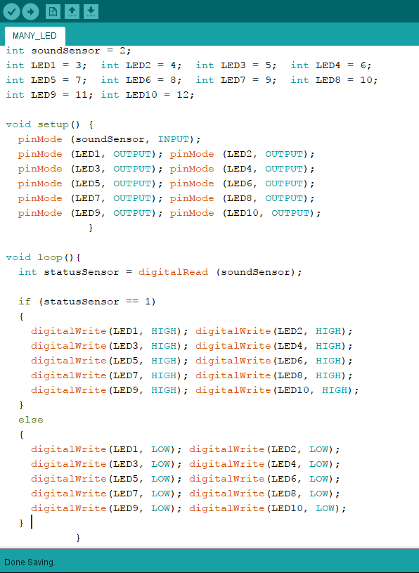
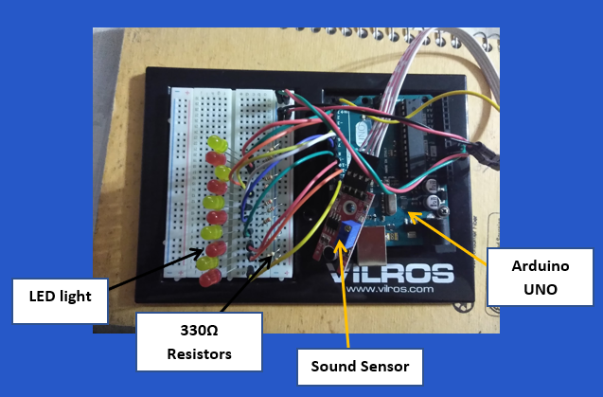
Current Design: Communications
Sound INPUT - Light OUTPUT Test
Notes:
KITHA
WE DID THIS TEST TO SEE TEST HOW OUR SOUND INPUT COULD PRODUCE A DESIRED OUTPUT
TALK ABOUT DIFFICULTIES WITH THE NOT SO LOUD BUZZER
AND THE NOT SENSITIVE ENOUGH MICROPHONE SENSOR (UNIDIRECTIONAL MICROPHONE SENSOR)
ALSO HOW INITIALLY DID DIGITAL INPUT AND GOT REALLY BAD INPUT SIGNAL
DECIDED ON ANALOG INPUT AND ACHIEVED MUCH BETTER INPUT SIGNAL

Slide 24
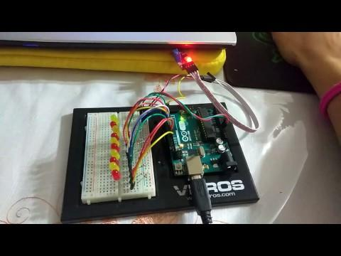
Current Design: Communications
Notes:
KITHA
RESULTS OF OUR TEST
WORKS PRETTY WELL BUT AGAIN WE NEED BETTER COMPONENTS
NEED TO ORDER A BETTER BUZZER AND USE AN OP AMP TO AMPLIFY THE SIGNAL
AND WE WOULD ALSO LIKE TO ORDER A MORE SENSITIVE OMNIDIRECTIONAL MICROPHONE SENSOR

Slide 25
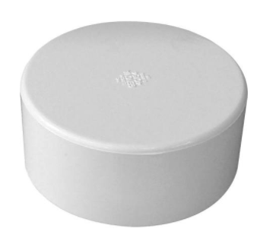
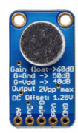
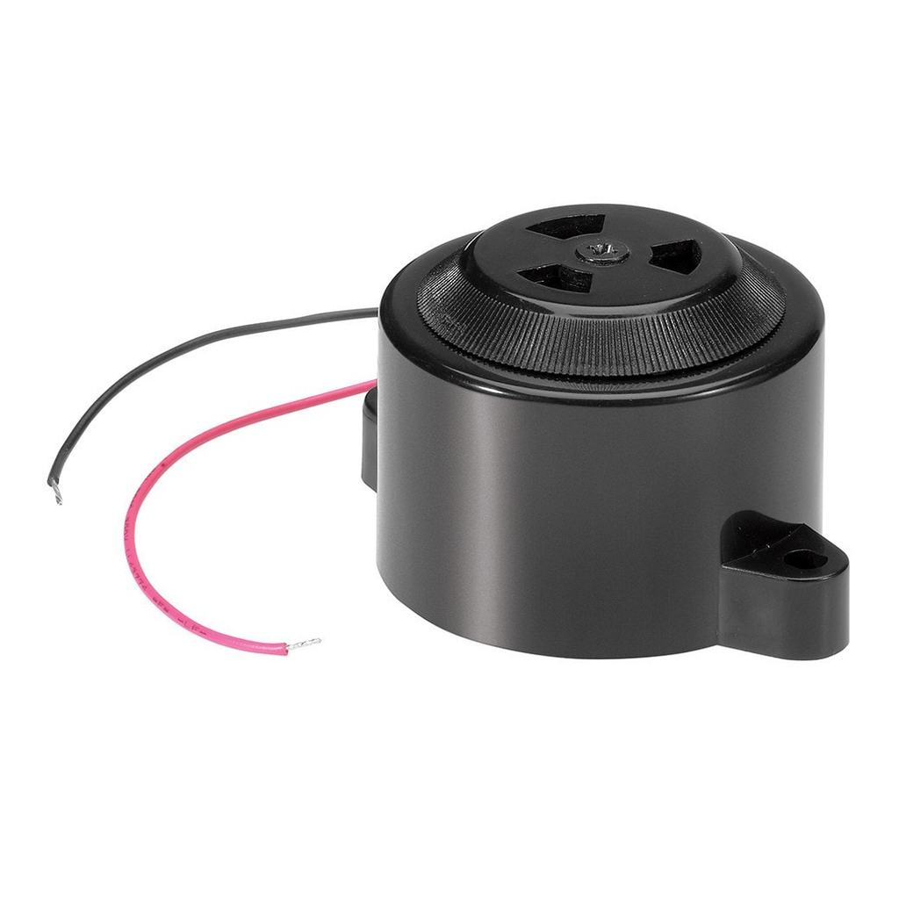
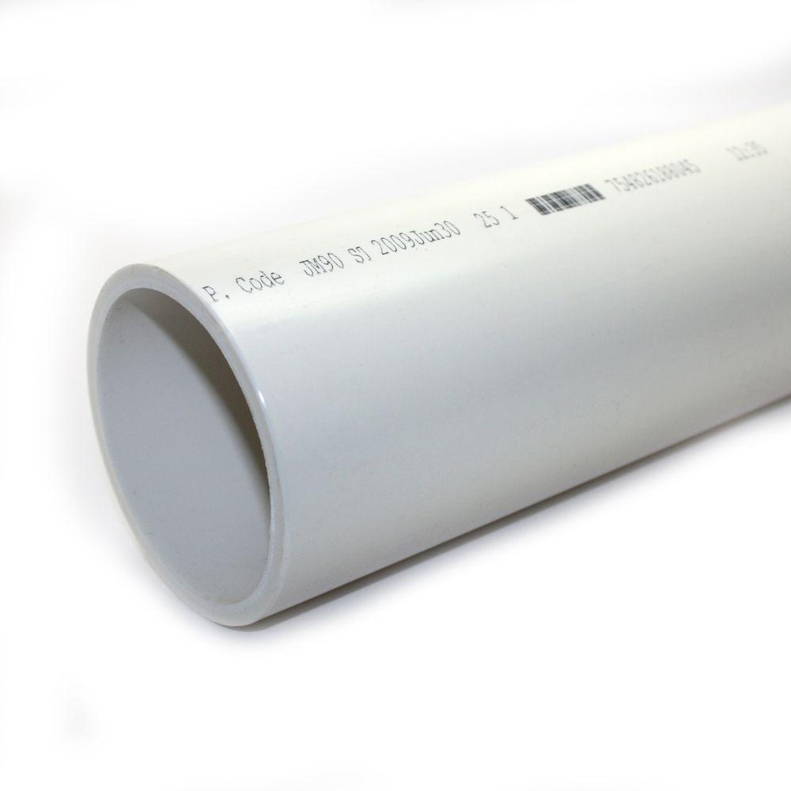
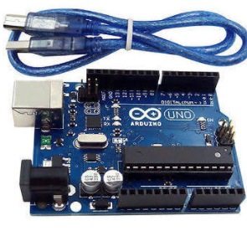
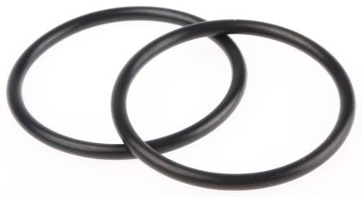
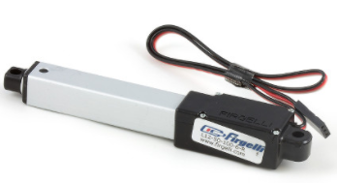
Parts List and Cost Analysis
Part | Quantity | Price
4’’ PVC PIPE | 1 | $10.00
4’’ PVC Pipe Caps | 2 | $6.00
Arduino UNO | 1 | $22.00
Actuator | 1 | $70.00
Sound sensor | 1 | $7.00
Piezo Buzzer (6-16V) | 1 | $4.00
O-Rings | 4 | $18.00
Solenoid Valve | 1 | $17.00
¼-inch Tubing | 20 feet | $17.00
Total |  | $171.00
Notes:
al
Pipe- 304 stainless steel threaded pipe fitting $20.14
Standard-Wall 304/304L Stainless Steel Pipe Nipple $9.40
Actuator- Miniature Linear Motion Series $70
Motor
Arduino
Sensor
O-Rings-
4’’ PVC Pipe caps = $6.00
4’’X2’ PVC Pipe

Slide 26
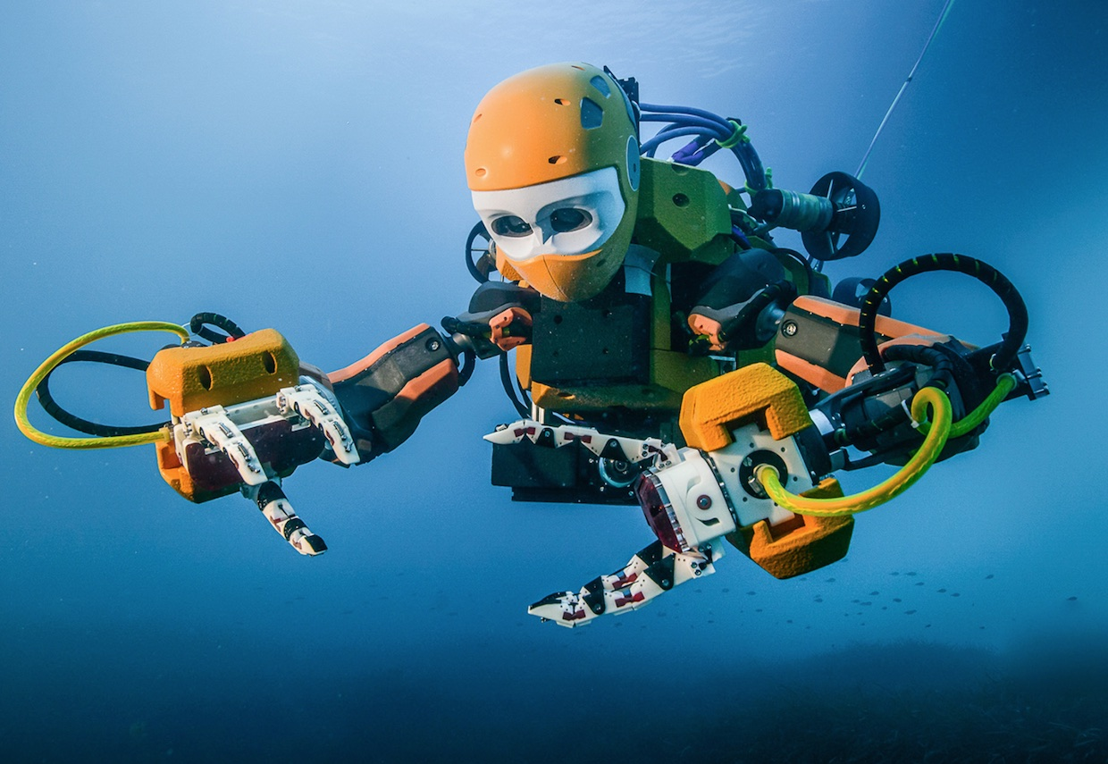
Future Work
Print out model components
Buy appropriate sound sensor and buzzer for system
Test water flow system
Assemble prototype
Underwater and performance tests
Final Prototype and analysis
Notes:
DAMINO/ KITHA

Slide 27
Gantt Chart
Task | Week 1 | Week 2 | Week 3 | Week 4 | Week 5 | Week 6 | Week 7 | Week 8 | Week 9 | Week 10 | Week 11 | Week 12
Print out solid models
Purchase tools and parts
Test water flow
Assemble the model
Test entire system under water
Submarine redesign
Final analysis
Notes:
VENEZUELA

Slide 28
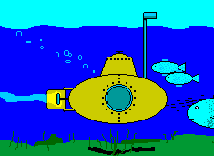
THANK YOU!

